Slide 1
Mitigation Planning and
FEMA Grant Opportunities
State Association of Kansas Watersheds Annual Meeting
Joe Chandler –Risk Analysis Branch
John Gassmann –Hazard Mitigation Assistance Branch
January 31, 2023

Slide 2
Purpose of the Mitigation Planning Process
Identify policies and actions that will reduce the risk of damage and loss
Enhance the ability of communities to recover from disasters quicker
Establish partnership for community resilience
Save lives and reduce risk from future disasters through risk-informed activities
Help direct mitigation resources to where they are most needed
Provide access to FEMA mitigation funding

Slide 3
FEMA Hazard Mitigation Plan Status

Slide 4
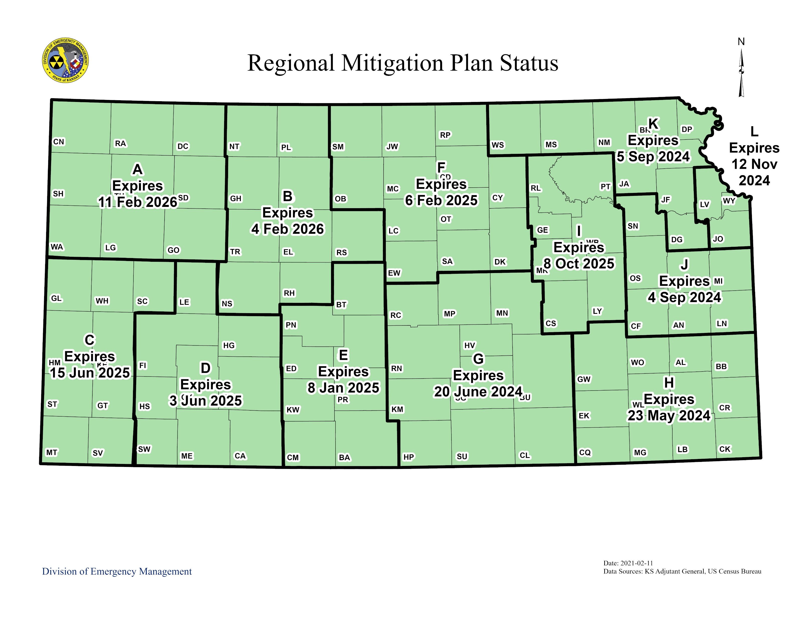
Kansas Regional Planning Areas
Mitigation is any sustained action taken to reduce or eliminate the long-term risk to human life and property from hazards.

Slide 5
The Mitigation Planning Process
Build on Existing Data
Evaluate and Update
Implement and Monitor
Identify Problem
Propose Solution
Adopt the Plan
Involve the Public
Notes:
The planning process section has clarified the requirements about which stakeholders must be given an opportunity to participate, when this needs to occur, and what information needs to be documented.
All plan maintenance requirements have also been moved to a separate element.

Slide 6
Planning Process Stakeholders
Local and regional agencies involved in hazard mitigation activities
Agencies that have the authority to regulate development
Neighboring communities, including special districts
Representatives of businesses, academia, and other private entities, such as private utilities and major employers that sustain community lifelines
Non-profits including community-based organizations that support underserved communities
Notes:
The planning process section has clarified the requirements about which stakeholders must be given an opportunity to participate, when this needs to occur, and what information needs to be documented.
All plan maintenance requirements have also been moved to a separate element.

Slide 7
Planning Process Engagement
Defines “involvement”, “participation”, and “opportunity to be involved” to promote meaningful engagement
Encourages participation from a broader range of stakeholders:
Local and regional agencies involved in hazard mitigation activities
Agencies that have the authority to regulate development
Neighboring communities, including special districts
Representatives of businesses, academia, and other private entities, such as private utilities and major employers that sustain community lifelines
Non-profits including community-based organizations that support underserved communities
Notes:
The planning process section has clarified the requirements about which stakeholders must be given an opportunity to participate, when this needs to occur, and what information needs to be documented.
All plan maintenance requirements have also been moved to a separate element.

Slide 8
Know Your Role in the Process
Connect with your emergency manager.
Get involved early and stay involved.
Connect with your emergency manager
Get involved early and stay involved
Use your engagement skills
Provide your knowledge of the built environment
Contribute data, knowledge, and perspective
Bring your knowledge of the built environment.
Contribute data, knowledge, and perspective.
Connect with your emergency manager.
Get involved early and stay involved.
Use your engagement skills.
Bring your knowledge of the built environment.
Contribute data, knowledge, and perspective.
Notes:
As planners, it is important to recognize just how important you are to the risk reduction conversation.
The planner’s role in the process includes:
Connecting with the emergency manager. The emergency manager often leads the planning process, but the most successful plans are a partnership between emergency management and planning.
Get involved early and stay involved.
Use your engagement skills. Chances are, you know the community well – bring your knowledge of who is in the community, how to reach them, and the right ways to engage inclusively.
Bring your knowledge of the built environment. Community planning and building codes are powerful ways to reduce risk. Community and land use planning governs where communities build. Building codes govern how communities build. Both are essential for a resilient future.
Contribute knowledge, data and perspective.

Slide 9
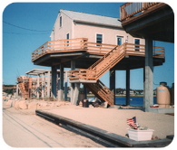
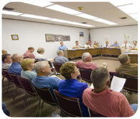
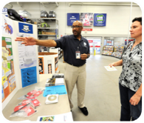
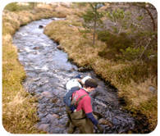
Range of Mitigation Action
STRUCTURAL PROJECTS
Acquisition
Elevation
Retrofits
Drainage
PLANS and/or REGULATIONS
Zoning Codes
Ordinances
Open Space Plan
NFIP
EDUCATION & OUTREACH
Public Awareness
Outreach
Educational Programs
NATURAL SYSTEMS PROTECTION
Stream and Wetland Restoration
Erosion Control

Slide 10
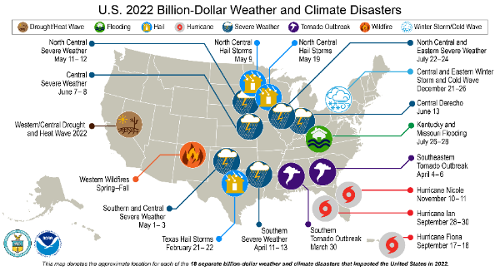
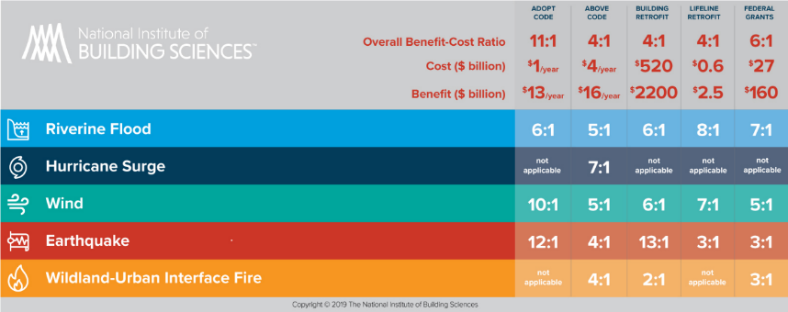
Why Mitigate?
Disasters are Costly
Mitigation Saves
NOAA National Centers for Environmental Information (NCEI) U.S. Billion-Dollar Weather and Climate Disasters (2022). https://www.ncei.noaa.gov/access/billions/
Notes:
In 2022, there 18 weather or climate disaster events with losses exceeding $1 billion each. The annual average of billion-dollar events for the last five years (2018-2022) is 17.8 events.
According to the National Institute of Building Sciences 2019 report called, “Natural Hazard Mitigation Saves,” certain mitigation actions can see a 12:1 return on investment in avoided damage. On average, using federal grants for mitigation actions results in a 6:1 ROI.

Slide 11
Hazard Mitigation Assistance Grant Opportunities
Hazard Mitigation Grant Program (HMGP)
Available after some Presidentially declared disasters
HMGP – Post Fire
Available after a Fire Management Assistance Declaration
Building Resilient Infrastructure and Communities (BRIC)
$2.295 billion available in FY2022
$2M State/Territory Allocation per applicant
$50M Tribal Set-Aside
$2.133B National Competition
Flood Mitigation Assistance (FMA)
$800M available Nationwide FY 2022
All grants require participation and adoption of a FEMA-approved local hazard mitigation plan.
Notes:
These are four Hazard Mitigation Assistance Grant Programs. BRIC and FMA are nationally competitive non-disaster grant programs
HMGP is disaster related. The total funding available is calculated based on how much federal disaster assistance the state/tribe receives. For states and tribes with a standard hazard mitigation planning program, the state receives an HMGP funding ceiling is established as 15% of the total disaster assistance award. HMGP is one of our most important grants for communities and comprises 82% of all Federal mitigation grants received in R7. It allows for wide ranging projects – must be based on mitigation activities identified in the community through the hazard mitigation planning process; traditionally have had major impacts in our communities toward building resilience;
BRIC is a relatively new program, initiated 2 years ago (FY20 funding) replacing the Pre-Disaster Mitigation Program (PDM) to focus on addressing most important issues communities face – moving forward with focus on equity and changing environment- BRIC has become a great opportunity for communities.
Flood Mitigation Assistance is for mitigating losses to NFIP insured structures.
Funding for both BRIC and FMA greatly expanded under IIJA for FY22. **Note: FY22 for both BRIC and FMA will be the upcoming application period. **

Slide 12
Hazard Mitigation Grant Program (HMGP)
After a Presidentially-Declared Disaster
Administered by the State/Tribe
Used Statewide (not limited to declared counties)
Requires FEMA-Approved Hazard Mitigation Plan
Available funds
15% of total disaster grants awarded by FEMA for States with approved Standard State Plan (20% for Enhanced State Plan)
Cost Share is 75% Federal and 25% Local**
Administered by State Emergency Management Agency
Notes:
HMGP is disaster related. The total funding available is calculated based on how much federal disaster assistance the state receives. For states with a standard hazard mitigation planning program, the state receives an HMGP award equal to 15% of the total disaster assistance award. In enhanced mitigation planning program states, the they receive 20%. KS and NE are both standard states; IA and MO are both enhanced states. In addition to ongoing disasters awards, all 4 states were awarded a total of $70M in HMGP related to COVID disasters.
**Note** Cost share for DRs with Decs or incident period from 1/1/2020 to 12/31/2021 are 90/10

Slide 13
Applying for BRIC
FY22 BRIC Priorities
FY22 NOFO released Aug. 5, 2022
Application period:
Opens Sept. 30, 2022
Closes Jan. 27, 2023 at 3:00 p.m. Eastern
Deadlines are similar each year
Mitigate the risk to public infrastructure (including natural systems)
Incentivize resilient investments in disadvantaged communities, as referenced in Executive Order 14008 (Tackling the Climate Crisis at Home and Abroad)
Incorporate nature-based solutions including those designed to reduce carbon emissions
Enhance climate resilience and adaptation
Incentivize the adoption and enforcement of the latest published editions of building codes
BRIC encourages mitigation projects that meet multiple program priorities!
Notes:
Each year, BRIC program priorities and application process are announced through a Notice of Funding Opportunity (NOFO). The NOFO is available online at link
In FY22, there are minor changes to the BRIC program priorities.
Greater emphasis and clarify that natural systems are included as infrastructure. BRIC Policy defines infrastructure as “critical physical structures, facilities, and systems that provide support to a community, its population, and economy.”
Removal of the priority to “mitigate risk to community lifelines,” as community lifelines are considered infrastructure by the BRIC Policy definition. Further, this priority shift enabled a stronger emphasis on incentivizing resilience investments in disadvantaged communities demonstrated through an increase in technical evaluation criterion points in the national competition. (Which will be seen later in the presentation).
Funding Amounts
In FY2020, FEMA made available $500 million of the BRIC 6% set-aside (per the Disaster Recovery Reform Act of 2018 (DRRA)) for the first BRIC application period. In FY2021, FEMA made available $1 billion from the BRIC 6% set aside. Based on submissions received at these funding amounts we anticipate similar oversubscriptions from our SLTTs in FY22 in response to funding availability.
The total funding amount for FY22 will be $2.295 B. This total funding amount is composed of $183 M from the first year of IJA/BIL funding for BRIC and the remainder from the DRF ($2.112 B). Accordingly, in FY22 the BRIC program has increased the State/Territory Allocation per applicant and Tribal Set-Aside.
Because of the increase in the total funding amount, the state/territory allocation was increased accordingly.
Regarding the Tribal Set-Aside (in BRIC and PDM) has historically been oversubscribed each year in response to annul incremental increases. With an increased Tribal Set-Aside in FY22, the program team anticipates a corresponding increase in funding requested to the Tribal Set-Aside.
Additionally, “geographic areas within Tribal jurisdictions” are identified as disadvantaged communities in Justice40 Interim Guidance; significantly increasing the Tribal Set-Aside supports the goal of the BRIC Program to meet Justice40.
A significant increase in the tribal set-aside also is a strong signal of support for tribal participation in BRIC. A Larger set-aside may encourage greater participation (dollars reserved for the tribes means they feel like they have greater chance to succeed).
Any funds not used in the Tribal Set-Aside will be re-allocated to the national competition.

Slide 14
Direct Technical Assistance
Support to communities without resources
Resilience planning and project design
Enhances a community's capacity
Advances community driven objectives
Project Scoping
Support to communities with some resources, but unsure of the best solution
Funds studies, design work, and application development
Ideally drives future HMA grant applications
BRIC options to identify and develop community mitigation solutions
Notes:
Direct Technical Assistance (DTA) gives full support to communities that may not have the resources to begin climate resilience planning and project solution design on their own. Through process-oriented, hands-on support, BRIC DTA will work to enhance a community’s capacity to design holistic, equitable climate adaptation solutions that advance numerous community-driven objectives.
FEMA will give wide-ranging support to BRIC DTA communities including climate risk assessments, community engagement, partnership building, mitigation and climate adaptation planning, and BRIC program requests throughout the grant lifecycle. Support for BRIC DTA communities will be given from pre-application activities to grant closeout.
Communities send a request through the online submission form that can be found here (Spanish submission form available here). FEMA will select requests for non-financial BRIC Direct Technical Assistance (DTA) from those that are submitted no later than 3 p.m. Eastern time on Jan. 27, 2023.
Utilizing these two options will give extra points in the FEMA technical Evaluation for the National Competition.

Slide 15
Applying for FMA
FY22 FMA Priorities
FY22 NOFO released Aug. 5, 2022
Application period:
Opens Sept. 30, 2022
Closes Jan. 27, 2023 at 3:00 p.m. Eastern
Deadlines are similar each year
Enabling equitable outcomes
Reducing complexity and barriers to entry
Focusing on climate resilience
Notes:
For FMA: Sub-applicant must participate in National Flood Insurance Program. Projects Must provide mitigation benefit to NFIP-insured structures
Cost Share
75%/25% for insured properties and planning grants; Up to 90%/10% for repetitive loss properties
Up to 100% Federal for severe repetitive loss
Key Changes to FY22
Remove barriers to flood mitigation assistance through a people first approach
Increase investments in disadvantaged communities
Incorporate nature-based solutions, and enhance climate resilience and adaptation

Slide 16
Section 406 – Public Assistance Program
Managed by the State/Tribe
Funded under Public Assistance
Funds mitigation measures in conjunction with repairing disaster-damaged facilities
Limited to declared counties & eligible facilities
Reduces the potential for future, similar disaster damage

Slide 17
Examples of Mitigation

Slide 18
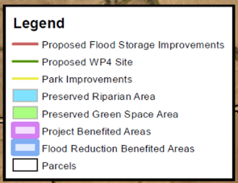
Flood Detention/Retention Papio-Missouri River NRD - Nebraska
Notes:
The Papio WP-4 Project is a flood risk reduction and water storage structure – a dam – in the central East part of the state, South Papillion Creek Basin Watershed near the city of Gretna, Sarpy County, Nebraska – about 20 miles west of Omaha. The structure is designed to control runoff from a 500-year rainfall event. The project is one of the originally planned 14 structures that, once constructed, will contribute to collective flood control benefits throughout the watershed by protecting homes, businesses, industries, and providing additional benefits of water quality improvement, streambank stabilization, and recreational opportunities throughout the Omaha-metro area.

Slide 19
Floodprone Property Acquisition Beatrice, Nebraska
After more than 45 years of purchasing floodprone property, the City of Beatrice witnessed firsthand the benefits of the program, when in May of 2015, the Big Blue River reached its third highest flood stage on record. The yellow highlight shows the properties that were in the 2015 flood inundation area that had been acquired by the time the flood occurred.
Flood of record 1973
Notes:
A Mitigation Effectiveness Study was done after the 2015 event that showed more than 90 structures would have been impacted by the 2015 flooding. The buyout saved approximately $13 Million in damages for this event.
Beatrice flooded again in 2019 and a follow-up study showed that $5.71 million dollars in flood damage was avoided. More than 60 acquired structures would have been impacted by this flood.
.

Slide 20
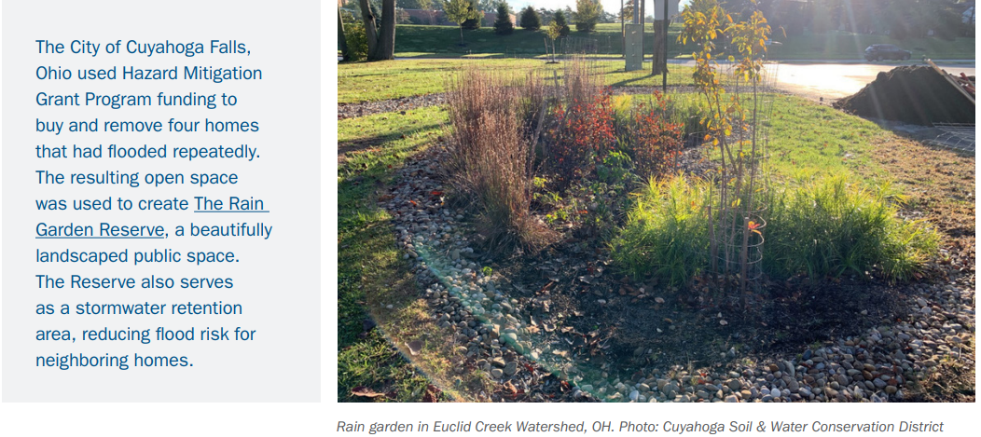
Floodprone Property Acquisition / Rain Garden – Cuyahoga Falls, Ohio
Photos/description coming
Notes:
The reserve serves as a stormwater retention area, reducing flood risk for neighboring homes.

Slide 21
Power Line Strengthening, Wind/Winter Storm Mitigation – Kiowa, Kansas
Notes:
In Kansas, the City of Kiowa upgraded 15 blocks of power distribution infrastructure that supply power to approximately 1,200 customers. They replaced open conductors with insulated cables and installed lightning arrestors at connection points.

Slide 22
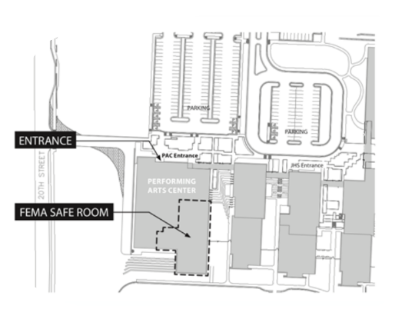
Tornado Saferooms – Joplin, MO
Notes:
14 school saferooms constructed in Joplin Since 2011 with federal assistance
Constructed in accordance with FEMA 361 Guidance for Community and Residential Saferooms
Near Absolute Protection
Withstand winds up to 250 mph
Multi-purpose rooms – gyms, offices, wrestling room, locker room, industry tech classroom, television production studio
Open to community residents
Automatic unlocking systems

Slide 23
Kansas Division of Emergency Management (KDEM)
For questions about KDEMs administration of grant programs and deadlines.
Stephanie Goodman, State Hazard Mitigation Officer
stephanie.goodman@ks.gov
(785)207-2396
For questions about KDEMs regional mitigation planning efforts.
Austin Bork, Mitigation Planner
austin.bork@ks.gov
(785)207-1558

Slide 24
Questions?
FEMA Region 7
Joe Chandler, Community Planner – joe.chandler@fema.dhs.gov
John Gassmann, HMA Branch Chief – john.gassmann@fema.dhs.gov

