Slide 1
Jackie Byam Acting State Conservationist Kansas NRCS
NRCS Watershed Programs
Notes:
INTRODUCTION

Slide 2
Watershed Programs
Watershed and Flood Prevention Operations Program (WFPO)
Watershed Rehabilitation Program (REHAB)
Emergency Watershed Program (EWP)
www.nrcs.usda.gov/programs-initiatives/watershed-programs
Notes:
NRCS watershed programs consist of the Watershed and Flood Prevention Operations Program, the Watershed Rehabilitation Program, and the Emergency Watershed Program. We more commonly refer to them by the abbreviations shown on this slide.
Today I will briefly go over each of these programs. NRCS also has a additional resources for these programs on our website that go more in-depth than I will today. You can access the guides and resources on the Watershed Program Resources Page of the NRCS website. You can also reach out to Laura Gray for additional information and resources.

Slide 3
Statutory Requirements
NRCS fund request must be for $25M or less.
Agriculture must consist of at least 20% of the monetary benefits.
The project must cover less than 250,000 acres.
No single structure within the project can provide more than 12,500 ac-ft of detention capacity or 25,000 acre-feet of total capacity.
Notes:
These are the statutory requirements for watershed program projects.
If funding requests are larger than $25 million, they will have to be congressionally approved.
When the project benefits are determined, at least 20% of the economic benefits must be directly related to agriculture. Benefits to rural communities may be included as agriculture benefits.
The project must not exceed 250,000 acres in size.
None of the structures within the project can provide more than 12,500 acre-feet of detention capacity or 25,000 acre-feet of total capacity.

Slide 4
Sponsor Responsibilities
Provide power of eminent domain.
Acquire necessary permits, licenses, and agreements.
Have the authority to levy taxes.
Arrange for and carry out activities that involve public participation in planning.
Provide funding for necessary cost share, operation, and maintenance.
Implement the necessary water management features.
Notes:
Any entity that wishes to be a sponsor for a watershed project must agree to fulfill the responsibilities listed here.
The NRCS Watershed Program website has sponsor resources available for the applicable program.

Slide 5
WFPO
Program Purposes:
Flood Prevention (Watershed Protection)
Public Recreation
Public Fish and Wildlife
Agricultural Water Management
Municipal and Industrial Water Supply
Water Quality Management
Water Structure Rehabilitation
Notes:
The WFPO program allows NRCS to aid in the development of watershed project plans and actions for the purposes of; flood prevention, public recreation, public fish and wildlife, agricultural water management, municipal and industrial water supply, water quality management, and water structure rehabilitation.

Slide 6
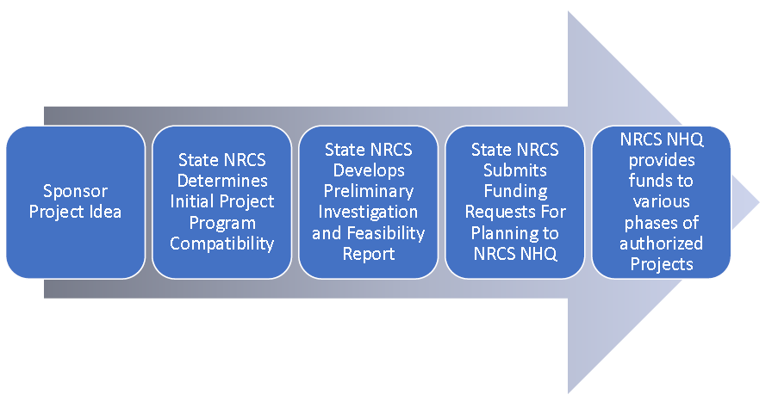
WFPO
Notes:
This diagram goes through the WFPO program steps.
When a sponsor has an idea for a project, they can start by contacting their local NRCS district conservationist.
The district conservationist can arrange a meeting between the Project Sponsor and the State Program Manager to discuss the watershed issue the sponsor is having, options to solve to issue, and the requirements of programs that are available.
The NRCS state office will need to complete a Preliminary Investigation and Feasibility Report to determine whether the project is compatible with the WFPO program and whether there are any insurmountable obstacles.
If the report shows that the WFPO program can be used for the project, the sponsor and State Conservationist will then submit a request for funds to prepare either an environmental assessment or an environmental impact statement for the watershed plan. Funding requests can be submitted by the State Conservationist at any time. NRCS National Headquarters will evaluate the funding request and decide whether funding will be provided.

Slide 7
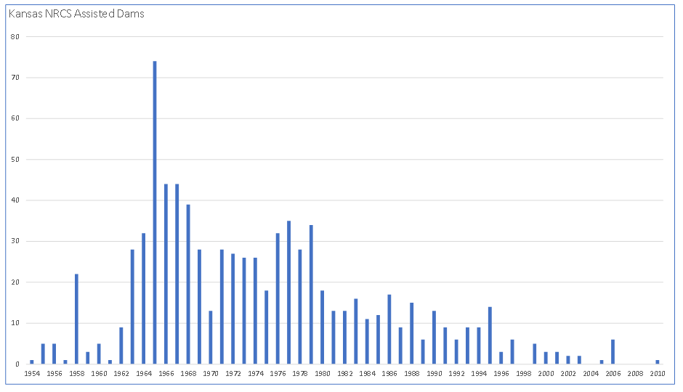
REHAB
Notes:
This chart shows the number of NRCS assisted dams that were built in Kansas each year. As you can see, most of these dams are more than 40 years old. Many of these older dams can still provide a benefit, but their components start deteriorating and they might not meet today’s safety and performance standards, especially if the hazard classification has been increased due to downstream development. The NRCS Rehab program helps sponsors complete the necessary work to extend the service life of their dam and meet these performance standards.

Slide 8
REHAB
Program Stages:
Assess the conditions of the dam.
Develop a rehabilitation project plan.
Design the rehabilitation.
Implement the rehabilitation (construction).
Notes:
If a sponsor wishes to rehabilitate a structure, they must start by submitting an assessment request to the NRCS State Conservationist. If you need help with this, you can contact your local NRCS office. If the request is approved, an assessment report will be created for the sponsor that explains the risks to the public should the dam fail and provides preliminary REHAB alternatives with an estimated cost for each alternative. The sponsor will then use the information from the assessment report to determine whether to proceed with the rehabilitation of the structure.
If the sponsor chooses to move forward with the REHAB, they will submit an application to the NRCS State Conservationist. If the application is approved, the state NRCS office will work to; identify potential problems, evaluate alternatives more closely than in the assessment stage, and develop a plan to rehabilitate the structure.
If the plan is authorized by the NRCS Chief, the REHAB can move forward with design. The design must meet the requirements for both NRCS and DWR.
After the design is approved, the construction stage can begin.

Slide 9
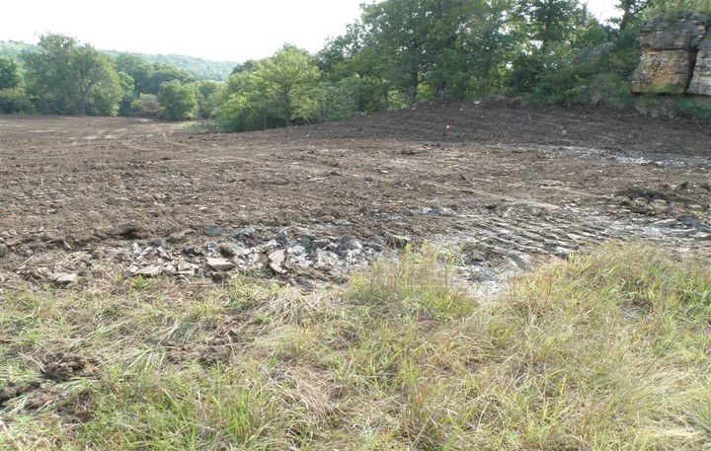
EWP
Notes:
The EWP program allows NRCS to provide technical or financial assistance to safeguard lives and property from floods, drought, and the product of erosion whenever a natural occurrence is reducing the ability of a watershed to carry out its natural function. For example, this picture shows an auxiliary spillway that had eroded from a storm and was repaired using assistance through the EWP program.

Slide 10
EWP
EWP Requirements:
An emergency must be declared for an event.
A formal request for EWP assistance must be submitted within 60 days.
Disaster occurrence
Site access is available
Notes:
EWP can only be used when an emergency has been declared for an event. This can either be a federal emergency declared by the President or a local watershed emergency declared by the NRCS State Conservationist.
A formal request for EWP assistance must be submitted to the NRCS state conservationist within 60 days of the disaster occurrence. In instances such as flooding where you are unable to access the site right away, the request can be submitted within 60 days from the time access to the site becomes available.

Slide 11
EWP
Informal Discussions
Formal Sponsor Request
Damage Survey Report
Funds Available
Notes:
This diagram goes through the EWP program steps.
Meetings and site visits between NRCS and a sponsor can occur at any time
NRCS will investigate and make the determination if EQP assistance is applicable
The Damage Survey Report contains the proposed EWP practices and estimates the cost. The DSR is completed within 60 days of the formal sponsor request
If national funds are available and the DSR meets the requirements, funding will be provided to NRCS. If EQP funds are not available, the DSR will be placed on a waitlist

Slide 12
USDA Non-Discrimination Statement
In accordance with Federal civil rights law and U.S. Department of Agriculture (USDA) civil rights regulations and policies, the USDA, its Agencies, offices, and employees, and institutions participating in or administering USDA programs are prohibited from discriminating based on race, color, national origin, religion, sex, gender identity (including gender expression), sexual orientation, disability, age, marital status, family/parental status, income derived from a public assistance program, political beliefs, or reprisal or retaliation for prior civil rights activity, in any program or activity conducted or funded by USDA (not all bases apply to all programs). Remedies and complaint filing deadlines vary by program or incident.
Persons with disabilities who require alternative means of communication for program information (e.g., Braille, large print, audiotape, American Sign Language, etc.) should contact the responsible Agency or USDA’s TARGET Center at (202) 720-2600 (voice and TTY) or contact USDA through the Federal Relay Service at (800) 877-8339. Additionally, program information may be made available in languages other than English.
To file a program discrimination complaint, complete the USDA Program Discrimination Complaint Form, AD-3027, found online at How to File a Program Discrimination Complaint (www.usda.gov/oascr) and at any USDA office or write a letter addressed to USDA and provide in the letter all of the information requested in the form. To request a copy of the complaint form, call (866) 632-9992. Submit your completed form or letter to USDA by:
(1) mail: U.S. Department of Agriculture
Office of the Assistant Secretary for Civil Rights
1400 Independence Avenue, SW
Washington, D.C. 20250-9410;
(2) fax: (202) 690-7442; or
(3) email: program.intake@usda.gov.
USDA is an equal opportunity provider, employer, and lender.
Notes:
Are there any questions?

