Slide 1
2/1/2023
State Association of Kansas Watersheds
Presenter: Jordan L.K Martincich, Vice President of Development – Pheasants Forever & Quail Forever
Notes:
Introductions

Slide 2
Our Goals for Today 1) Provide an Update 2) Present the Vision 3) Receive Input 4) Ask for help and Advice

Slide 3
Diverse Coalition of water, conservation, agriculture, recreation interests
Water, Water, Water – Quality, Quantity, Technology
Working Lands and Wildlife Habitat
Outdoor Recreation
Quality of Life
Information & Understanding
Notes:
Kansas’ abundant water, rich soils, diverse wildlife, fresh air, and wide-open spaces support the well-being of its people, families, and communities. However, both new and chronic challenges threaten these resources. Evidence shows that current conservation efforts, even aided by nature’s resilience and ability to restore itself, are not sufficient to ensure a future with healthy and sustainable water, land and outdoor recreation resources. As a result, the agriculture, industry and quality of life that depends on these resources is threatened.
Some of the natural resource issues Kansans face are daunting, but the Kansans for Conservation Coalition (Coalition) is committed to working together to ensure that our communities, economy, and individual well-being continue to be fueled by nature. The Coalition originated with multi-sector partnerships dedicated to addressing the challenges facing our state’s natural resources by securing stable, long-term funding for conservation strategies to meet those challenges. The Coalition is committed to broadening these partnerships to be inclusive of the diversity found in Kansas, including racial, ethnic, socioeconomic and geographical diversity.
The Coalition’s Guiding Principles are to: ● Steward water, land, wildlife, and wild places for long-term sustainability, quality of life, and economic vitality. ● Be inclusive and provide and encourage access to natural resources and nature-based recreation for all Kansans. ● Work hand-in-hand with the agriculture community and economy. ● Consider the long-term impacts of changing temperature and precipitation patterns

Slide 4
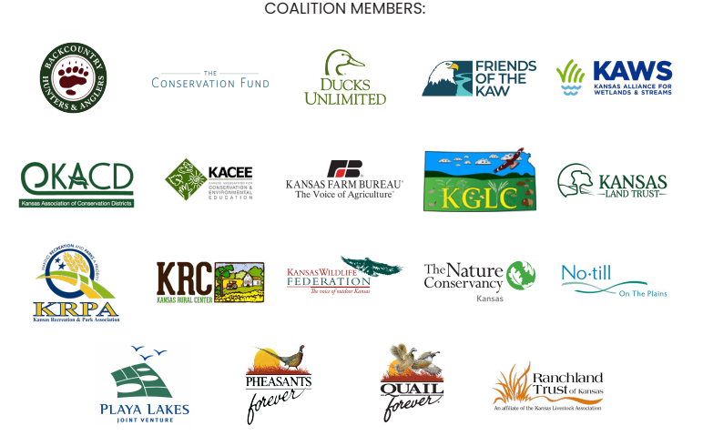

Slide 5
Timeline
2017: Coalition Building Begins
2018: Organization, Planning, and Feasibility Study (TPL)
2019:
2020: Continue Coalition Building and Begin Process of Filing Incorporation Docs
2021: Kansas For Conservation becomes 501c4
2022: Coalition Building Continues with emphasis on expansion, Meetings w/ Elected Officials
Needs Assessment, Polling, Meeting w/ Gov. Kelly, Case Statement, Draft Articles of Incorporation & By-Laws

Slide 6
WHAT KANSANS SAY…
Water conservation is #1
Being in nature is important
Positive towards legislators who support increased conservation, natural resource, and recreation spending

Slide 7
WHAT DO KANSANS WANT AND NEED?
Water Conservation and Land Conservation
Ground and surface water recovery and stability
Soil health & water quality
Improved dam and watershed management for water quality and habitats
Flood prevention
Better use and management of fire for rangeland health and catastrophic fire prevention
Restoration of degraded grazing lands
Proactive management of declining habitats and species
Notes:
Healthy, Clean, Abundant Water Water is important to every Kansan, every day. Clean, available water is vital for agriculture and industry; the health of our families, communities, and businesses; and the wild and natural environment. Most Kansans’ drinking water comes from public supplies in rivers and lakes. Much of Kansas’ crop production relies on irrigation from limited groundwater supplies. Strikingly, three-fourths of Kansas stream miles are contaminated or otherwise impaired for human use, and these streams flow into the state’s public water supply reservoirs. Treating water to remove contaminants to make it suitable for agricultural, industrial, municipal, or residential use is expensive. It is more cost-effective to prevent water quality degradation before it occurs, by applying proven land management practices across the state. By using both nature-based and engineered land management practices, the state’s waters can be improved without undue impacts to industry, agriculture, or municipalities.
With additional funding, Water Conservation strategies that could be expanded or initiated include:
Water Quantity – Promote and implement irrigation efficiency technology that reduces ground- and surface-water demand (and energy demand) without diminishing crop production; provide financial incentives; promote water policy that incentivizes reduced water use. Provide technical assistance and financial incentives to encourage producers to transition to dryland production.
Water Quality – Promote and implement land treatment practices that improve agricultural soil health, support crop production, and reduce sedimentation in surface waters; establish comprehensive stream water quality programs to prevent and mitigate water contamination; promote agricultural practices that improve crop yields, increase water-holding capacity of soils, increase infiltration of runoff, conserve groundwater, increase stream flows, and protect our drinking water supply. The protection, creation and enhancement of habitats for wetland and aquatic species will improve diversity and improve water quality.
Water Storage – Establish and promote modified reservoir operations and maintenance to provide the most efficient and reliable operation for water supply and flow, reduce sedimentation, purchase storage capacity.
Restoration and Management – Establish a comprehensive ecosystem restoration program to encourage protection of aquatic and riparian ecosystems from nuisance species, channel modifications, sediments, contaminants, and dewatering. Encourage restoration and protection of wetlands that filter out contaminants and provide recharge for groundwater aquifers.
Water Technology – Promote the development and use of technologies and informational programming related to water conservation technology and practices in agriculture, industry, and municipal uses.
WATER
Establish state matching funds to:
Capture federal funds and other resources available for wetland and riparian area protection, including the use of conservation easements
Restore stream connectivity and health by removing aging and hazardous dams, providing fish passage structures, and reconnecting stream channels with natural flood plains.
Fund:
Creation, protection, restoration, enhancement and maintenance of wetland and aquatic habitats
Restoration and stabilization of altered and unstable stream channels, using natural and engineered solutions.
Support of cost-effective and improved flood control measures, including managed forest riparian buffers, floodplain reconnection, and wetland development and restoration.
Provide financial incentives and/or technical assistance for:
Watershed management planning and practice implementation in all regions of Kansas
Creation of the broad use of water and soil management practices that reduce agricultural water demand; improve range management, incentivize broad use of field borders, riparian buffers, reduced tillage, cover crops, and less water-intensive crops.
Equitable water right retirement to reduce water demand in over-subscribed basins and groundwater areas; restore aquifer supplies, environmental stream flows, and wetlands.
Widespread adoption of soil health practices that improve water-holding capacity and drought resilience in crop production.
Improvement in groundwater and stream flows by advancing irrigation efficiency and crop technology.
Utilize reservoir dredging where it presents an economically and ecologically sound solution to lost storage capacity.
Identify and create uses and markets for lower quality water.
Modify reservoir dam operations, based on science and consensus of stakeholders, to reduce downstream erosion and provide for ecologically beneficial flows that support fish, wildlife, and aquatic recreation.
Develop career pathways and technical education programs to provide support for water conservation in agriculture and other realms.
Support research to improve groundwater and stream flows by advancing irrigation efficiency and crop technology.

Slide 8
WHAT DO KANSANS WANT AND NEED?
Agriculture
Irrigation efficiency
Grazing land rest, rotation, and management
Soil health and stability
Jobs in sustainable agriculture
Soil carbon markets
Expanded agricultural tourism
Restoration of marginal and unproductive lands
Notes:
WORKING LANDS
Provide state matching funds necessary to capture federal and other resources available for grassland protection, including the use of conservation easements.
Provide financial incentives and/or technical assistance for:
Managing deciduous forests, including regenerating key cottonwood stands and monitoring for disease and problem insects.
Broad use of prescribed fire that benefits grazing operations, ecosystem health, and water resources.
Encouraging cropping systems to reduce soil erosion and promote soil health.
Assisting landowners and operators in achieving optimal ecological and agricultural management of native grasslands and forests lands.
Assisting landowners and managers in testing and implementing new farming and ranching practices that benefit both ecosystem health and economic well-being.
Forest management in both rural and urban areas, including professional and layperson training.
Ensuring that only non-invasive trees are used in shelterbelts and windbreaks.
Develop robust markets for soil carbon and other agriculture-dependent ecosystem services, as well as soil health and land management practices necessary to capture those markets.
Fund conservation easements for the protection of large, intact and connected areas of private native grasslands (including CRP tracts) and forests.
Conduct research necessary for a comprehensive exotic and invasive species management program, including assistance with prescribed fire, mechanical practices, and other techniques.
Provide public education and information regarding the impacts of ecosystem fragmentation, woody plant invasion, ill-sited energy development, and other land uses.

Slide 9
WHAT DO KANSANS WANT AND NEED?
Quality of Life & Economic Development
Trails, natural areas, wildlife habitats
Hunting, angling, camping & hiking
Better local, county and state recreation facilities
Improved outdoor and environmental education opportunities
More outdoor opportunities near population centers
Increased economic and employment opportunities in agriculture and outdoor recreation
Notes:
WAY OF LIFE
Provide financial incentives and/or technical assistance for:
Encouraging landowners to provide access for outdoor recreation including opportunities to help landowners in low-income regions of Kansas.
Local, county, and state recreational facilities development, operations, and maintenance in order to promote exposure to and conservation of natural areas.
Expanding and enhancing the Kansas stream access program.
Support the creation of:
Civic groups dedicated to improving inclusion in outdoor recreation education and natural
Urban and rural trail systems that can be used for recreation and to improve human health.
Nature-contact spaces and opportunities for urban, suburban and rural children.
Statewide approach providing safe and accessible outdoor recreational opportunities for all Kansas communities, including access to natural areas, through the Statewide Comprehensive Outdoor Recreation Plan (SCORP).
Education programs for students to learn the values of conservation and gain appreciation for outdoor recreation in alignment with the Kansas Green Schools Program.
A state youth conservation corps or similar natural-resource-oriented jobs program
Support underrepresented groups engaging with outdoor recreation.
Update and maintain Kansas’ recreational lands and facilities data base.
Aid parents in feeling safe and confident in exploring natural areas with their children.

Slide 10
WHAT DO KANSANS WANT AND NEED?
Capture other funding sources that require matching
LWCF = $900 million annually nationwide
USDA RCCP = $300 million annually
USDA ACEP = $450 million annually
USFWS NAWCA = $60 million annually
NFWF
USDA AFRI
USDoI Legacy Conservation Areas
DoD Sentinel Landscapes

Slide 11
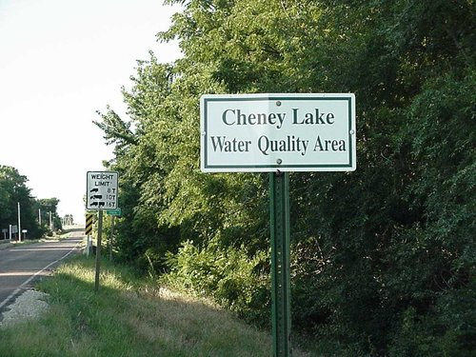
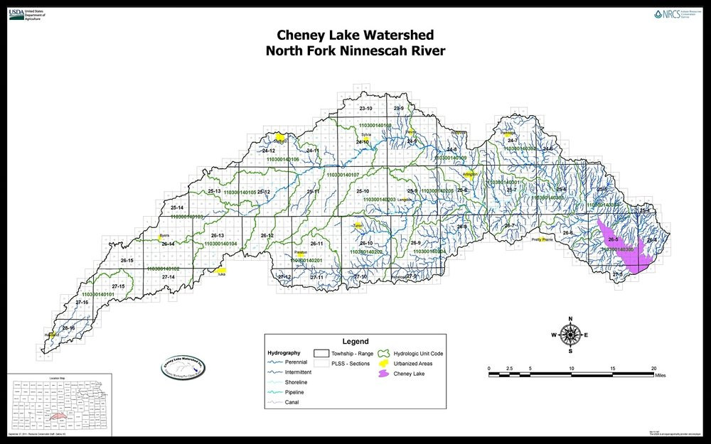
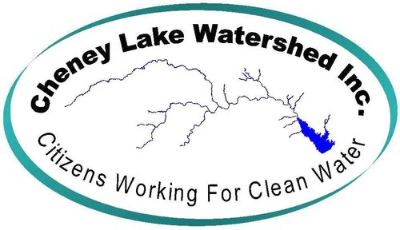
A real world example

Slide 12
HOW MUCH DO WE NEED? WHERE DO WE GET IT?
At a minimum we need $50 million annually to fund the Kansas Water Office Blue Ribbon Funding Task Force plan recommendations.
Long-term goal of $100 million to provide funding for water and other resources priorities (land, recreation, wildlife habitat, quality of life)
VOTERS SAY…
PORTION OF EXISTING TAXES
GAMING TAXES
SLIGHT SALES TAX INCREASE
SPORTING GOODS, OUTDOOR EQUIPMENT

Slide 13
OTHER STATES HAVE RISEN TO THE CHALLENGE…
Missouri – 1/10 of 1% existing sales tax = $90 M annually
Arkansas – portion of sales tax = $40 - $60 M annually
Minnesota – 3/8 of 1% sales tax increase
Nebraska – portion of lottery funds = $320 M since 1992

Slide 15
THANK YOU!
The time is now for Kansans to take action! Future generations are counting on us…
QUESTIONS, ADVICE, COUNSEL???
If you represent an organization that has a vested interest in this endeavor, we would welcome your participation in the Coalition.

